Slide 1


Smart Account
Project Release
V 1.0 - 7/26/18
Team: SmartAccount
Team Member
Haoran Li Hang Yuan Qingyuan He Yujia Li

Slide 2
Smart Account
Motivation
Track our daily expenses
Learn how to collaborate
Study how a product to be developed
Make our knowledge “useful”

Slide 3
Smart Account
Goals
SET OUT TO ACHIEVE
Basic Functions:
add/edit/delete/view history
user sign in or sign up
analysis visualization
Advanced Functions:
future prediction
group account
Features:
easy to start
concise UI
HAVE ACHIEVED
Basic Functions
Features

Slide 4
Smart Account
 | Challenges | Accomplishments
FInal Project | Database: real-time -> local Data visualization Bugs forever | How to use Android Studio Clean code
Development Process | No experience Limited time Unfamiliar technologies Member quited | Scrum Experience Collaboration

Slide 5
Smart Account
DEMO-video

Slide 6
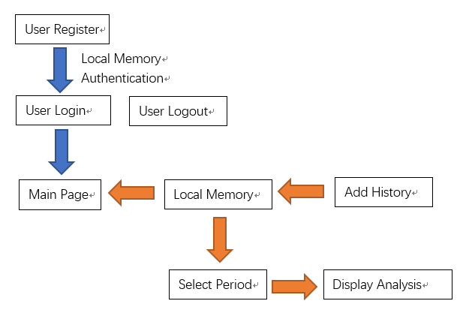
Smart Account
System diagram

Slide 7
Smart Account
Project Management
Scrum
Daily Meeting
GitHub
Google Drive

Slide 8
Smart Account
Enjoyed | didn’t Enjoyed
Collaboration
Developed an app
Achieve basic goals
The progress
from 0 to 99
Debug
Too many documents
Cannot achieve all the goals we set
eg: group functions

Slide 9
Smart Account
Lessons Learned
What worked
What didn’t worked
Things wished had done
Project management
Scrum
Github
···
Collaboration with Android Studio
Develop together
Firebase
The group and prediction functions
Even better UI
Real-time database

Slide 10
Smart Account
Thanks for Listening!
Smart Account

